Slide 1
Feature-preserving vector field denoising
João Antônio Recio da Paixão
Advisor: Hélio Lopes
Co-Advisor: Thomas Lewiner
Matmidia Laboratory – Department of Mathematics
PUC–Rio – Rio de Janeiro, Brazil

Slide 2
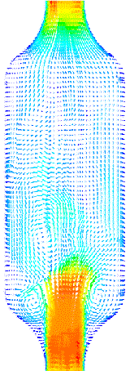
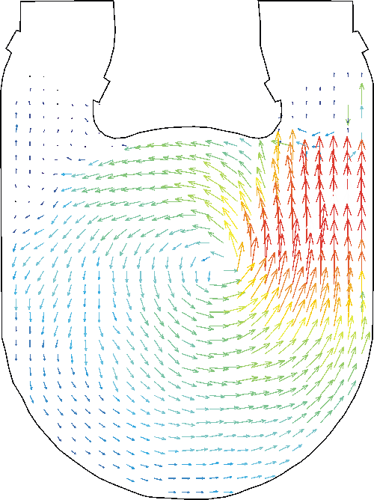
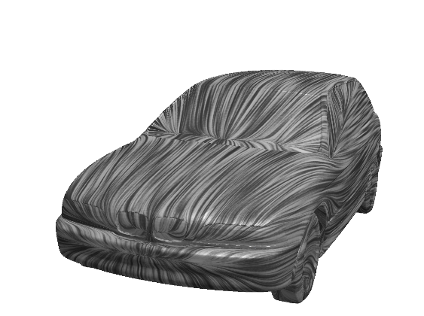
Vector Fields in Science
Notes:
Vetores = Movimento
Imagem medica
Fluxo dentro de um tubo de vidro
Aerodinamica de carro

Slide 3
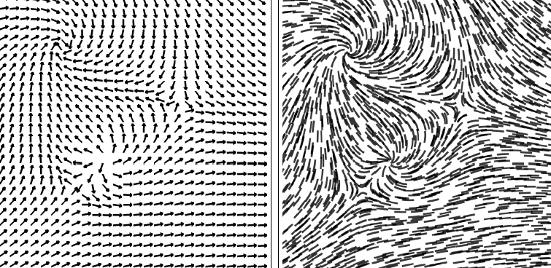
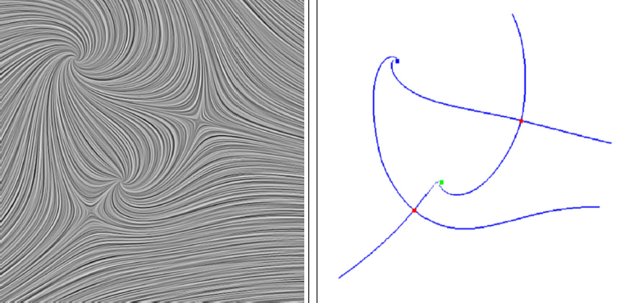
Vector Field Visualization
Notes:
Estudar e analisar
Coord uma por uma e’ruim
Visualizacao grafica
Setas= ruim
Linhas de fluxo
LIC – sensacao visual= facil de ver as sigularidades
Esqueleto = grafo topologico

Slide 4
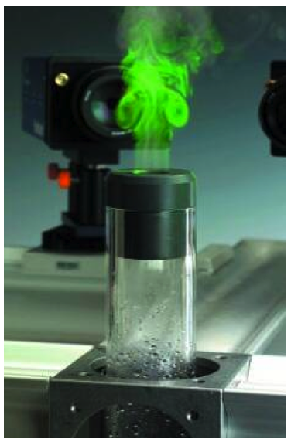
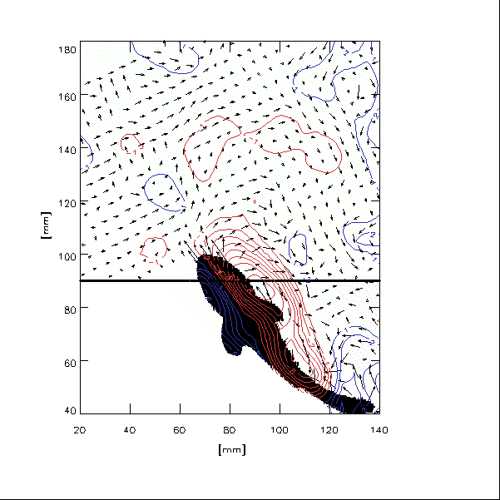
Noise in vector field acquisition
Particle Image Velocimetry(PIV)
Notes:
(PIV) became an important and active research field in mechanical engineering. It is concerned with the quantitative investigation of fluids by imaging techniques [11]. PIV systems captures the light scattered by small particles in a flow, and extracts from the image sequence a set of points equipped with their estimated velocity vectors.Particle Image Velocimetry
Navier Stokes= nao tem solucao analitica
Medida= groundtruth
splash

Slide 5
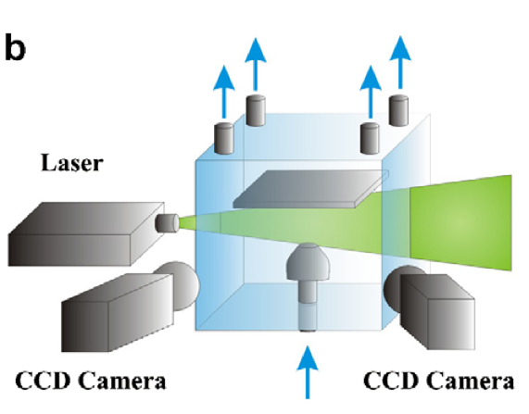
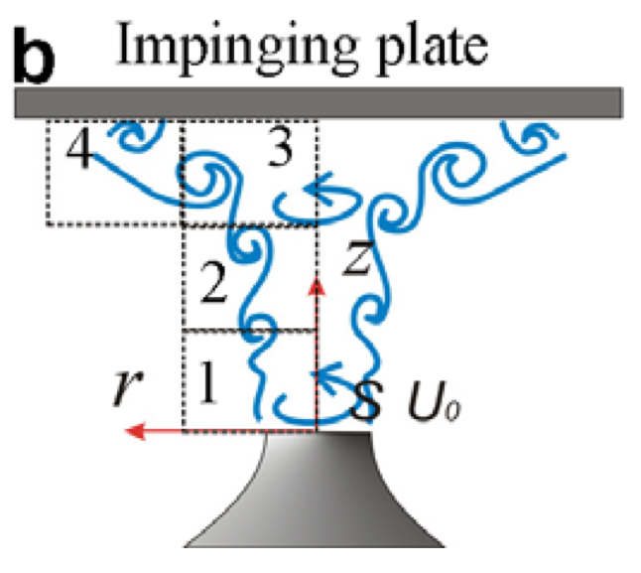
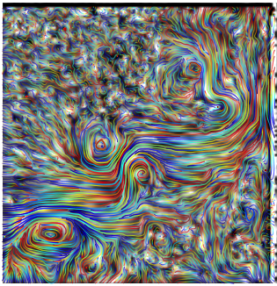
PIV Data
Data: Luis Alzuguir and Juliana Abrantes
(Dept. of Mechanical Enginerring, PUC-Rio)
Notes:
Jato Rodopiante
Figure 6(a) shows the input data with 15607 points. This sampled velocity field corresponds to a flow of a gas that is continuously injected horizontally on the bottom left corner. This gas flows on the domain from left to right until it meets an wall, represented on the image by its right edge.

Slide 6
Denoising
Noisy vector field
Denoised vector field

Slide 7
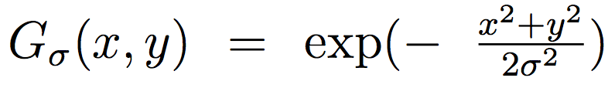
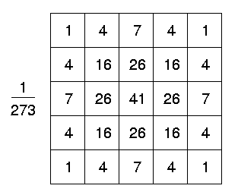
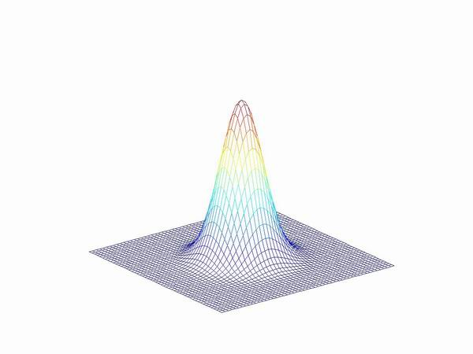
White Noise: Gaussian Filtering
E.g. 5x5 Gaussian Mask
Notes:
Teoria de shannon
Aquisicao e’ muito precisa e ruido e’ ideal
Media ponderada pela gaussiana

Slide 8
Loss of Discontinuities
Original
Original + Noise
Gaussian

Slide 9
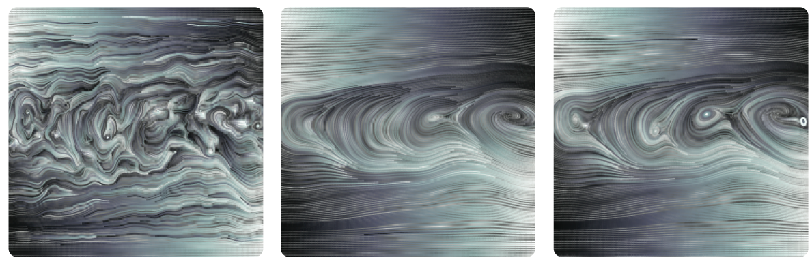
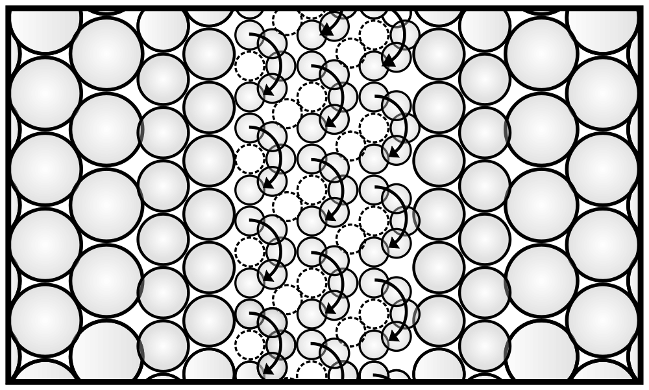
Loss of Singularities
Simulation of a shear band
Configuration
Original
Gaussian
Data: Alex Bordignon (Dept. of Mathematics, PUC-Rio)

Slide 10
Feature-preserving denoising
Random walk filter
Topology-aware filter
Notes:
Feature preserving
Simple formulation
Topology preserving
Aproveita o conhecimento do usuario
Mudanca de regime

Slide 11
Related Work

Slide 12
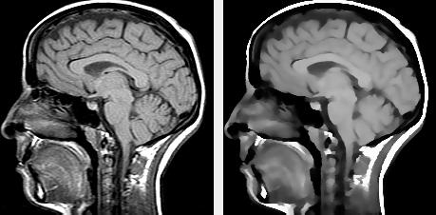
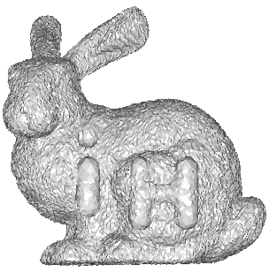
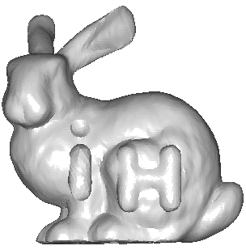
Random Walks
Image Denoising (Smolka et al. 2001)
Mesh Denoising (Sun et al. 2007)
Notes:
Features aonde o gradiente da funcao muda rapido
Features de curvatura
RANDOM Walk is mais interessante em campos pelas caracteristicas diferentes

Slide 13
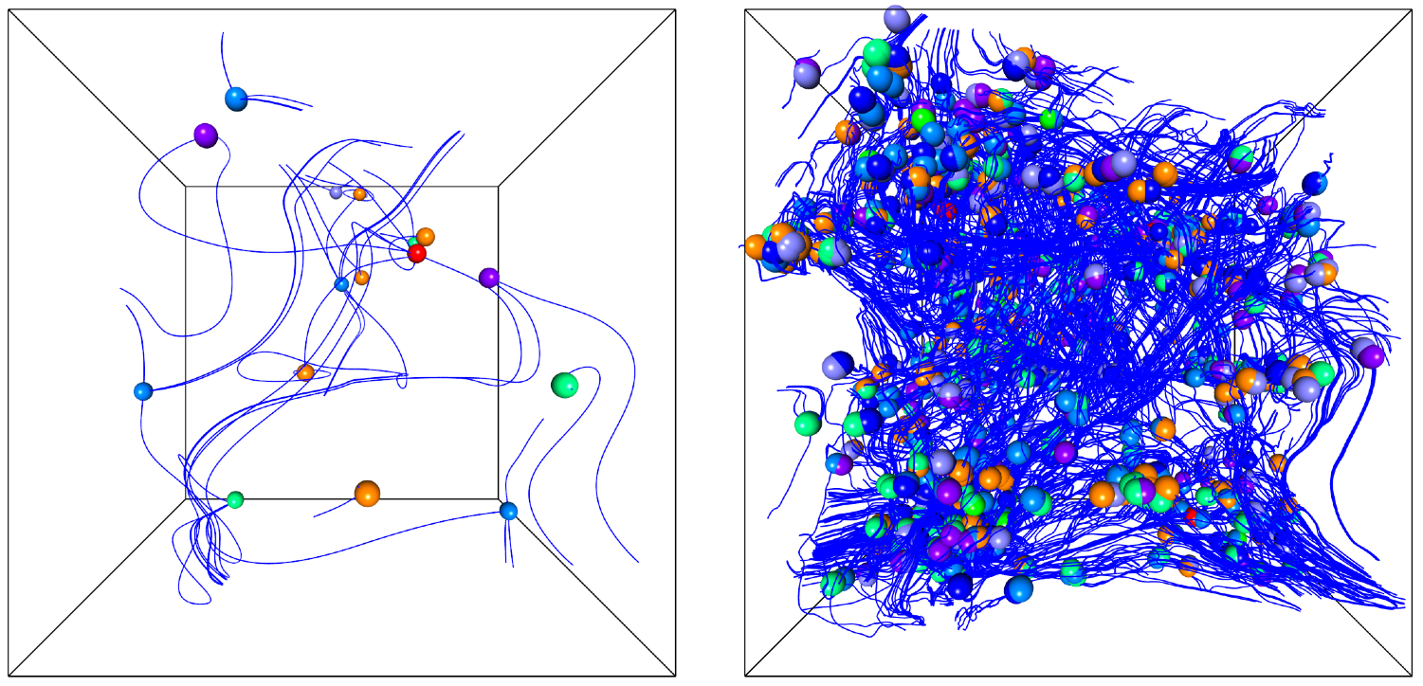
Vector Field Scale space
Tracking of singularities (Klein and Ertl 2005)

Slide 14
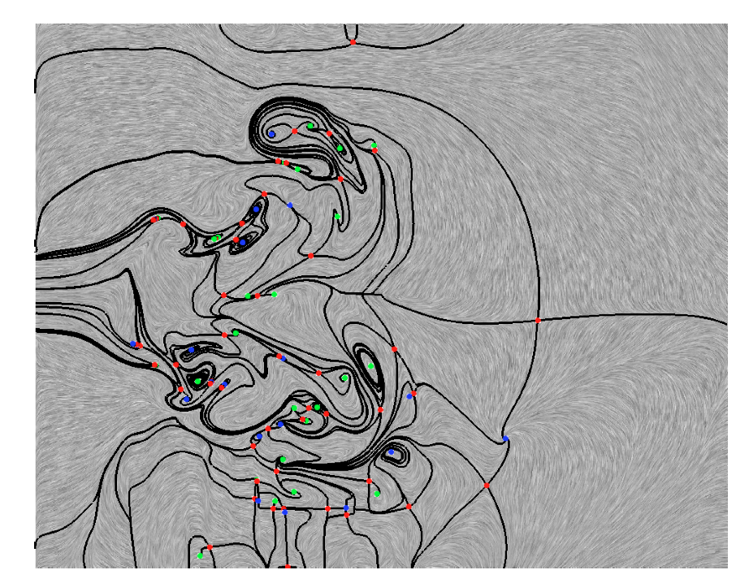
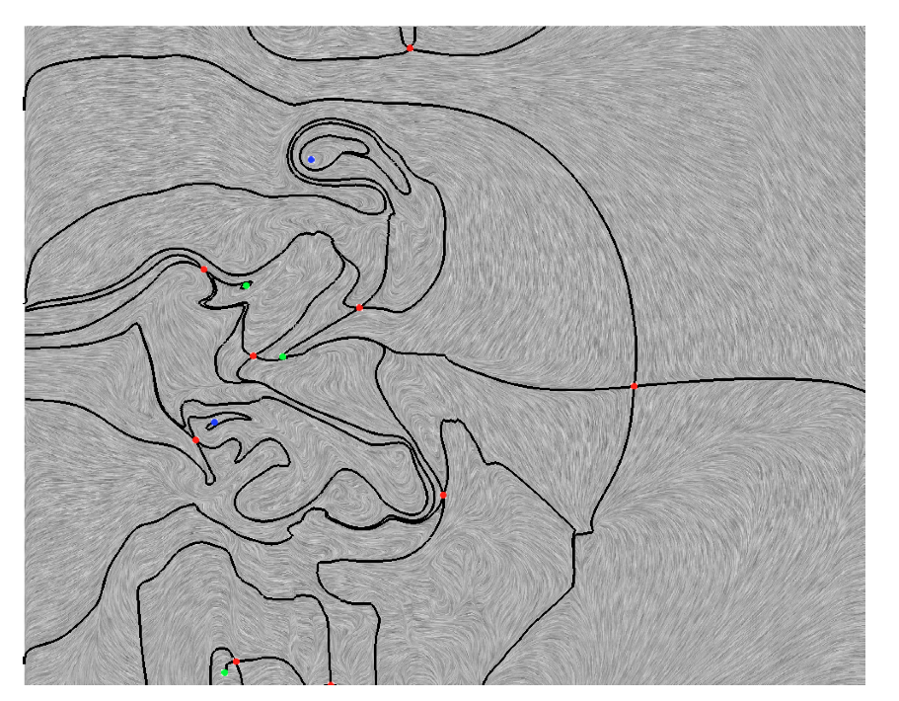
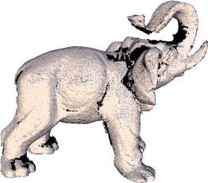

Topology simplification
Topology simplification of vector fields (Tricoche 2002)
Topology-aware user interaction (Sharf et al. 2007)
Notes:
Em cima do esqueleto topologico
USER-> Surface reconstruction

Slide 15
Random Walk for Vector Field Denoising
“Random Walk for Vector Field Denoising”(SIBGRAPI 2009)

Slide 16
Random Walks for Vector Field Denoising
What do we want?
Framework for filters
Simple design to define features
Random Walk
What do we need?
Graph
Probabilities to preserve features

Slide 17
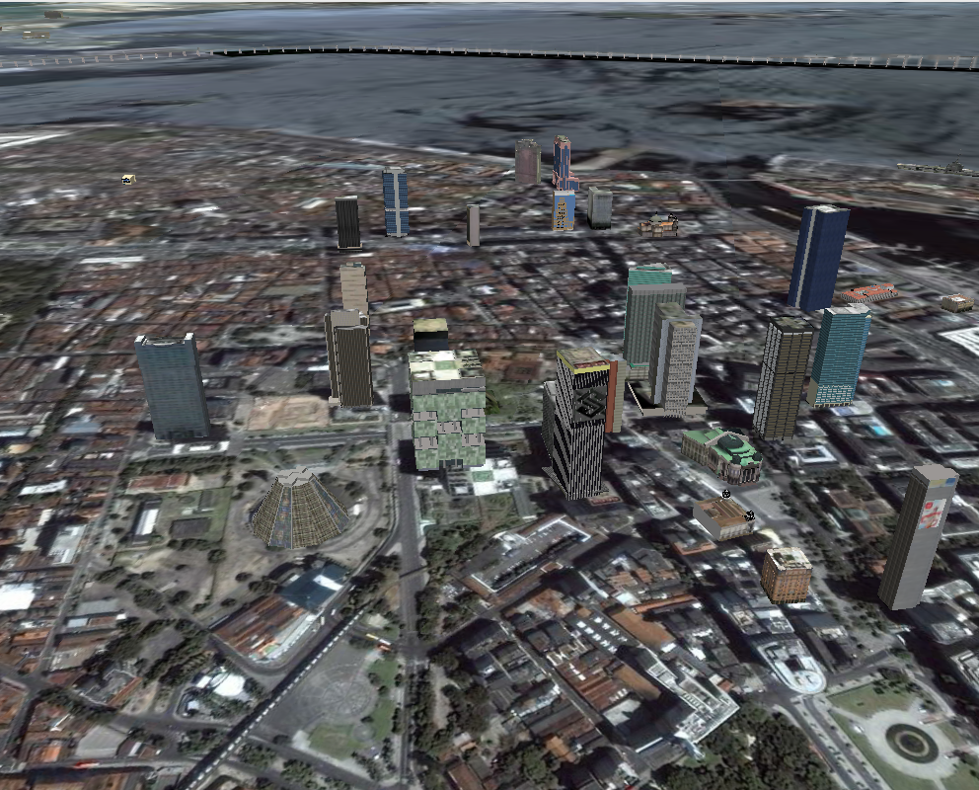
Random Walk Filter
Feature

Slide 18
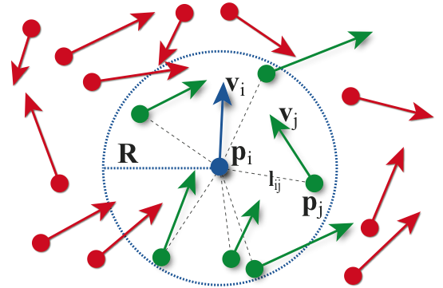
Graph

Slide 19
Probabilities
Probability from vector i to vector j
is the neighborhood of vector i.
2
4
1
3

Slide 20
Random Walk Filtering
Weighted Average of Random Walk Probabilities
- the probability of going from vector i to vector j after n steps

Slide 21
Examples of Similarity Functions
Direction
Magnitude

Slide 22
Probabilities
Probability from vector i to vector j
is the neighborhood of vector i.

Slide 23
Probabilities
Probability from vector i to vector j
is the neighborhood of vector i.

Slide 24
Probabilities
Probability from vector i to vector j
is the neighborhood of vector i.

Slide 25
Probabilities
Probability from vector i to vector j
is the neighborhood of vector i.
Notes:
ESCOLHA E’ LOCAL!!!

Slide 26
Illustrative Example
Original
Original + Noise
Gaussian
Random Walk
Notes:
Apesar do ruido ser guassian, amostragem nao e’ adequada (Shannon)

Slide 27
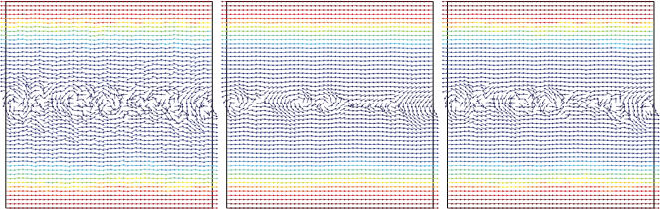
Granular Flow
Original
Gaussian Filter
Random Walk

Slide 28
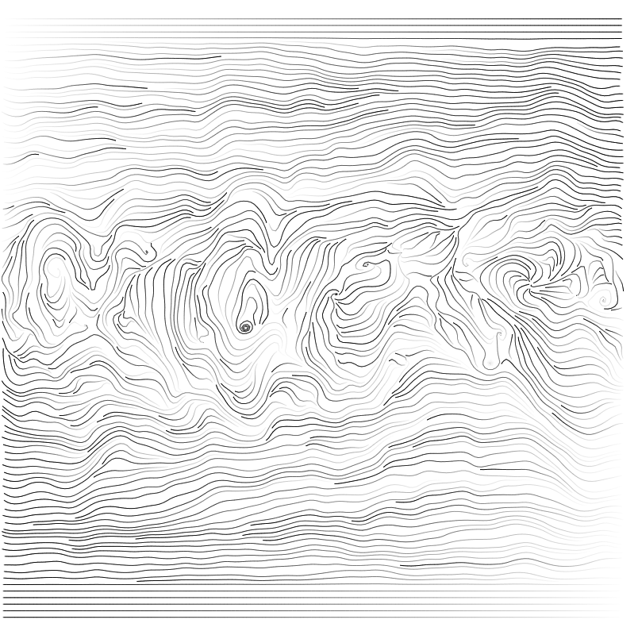
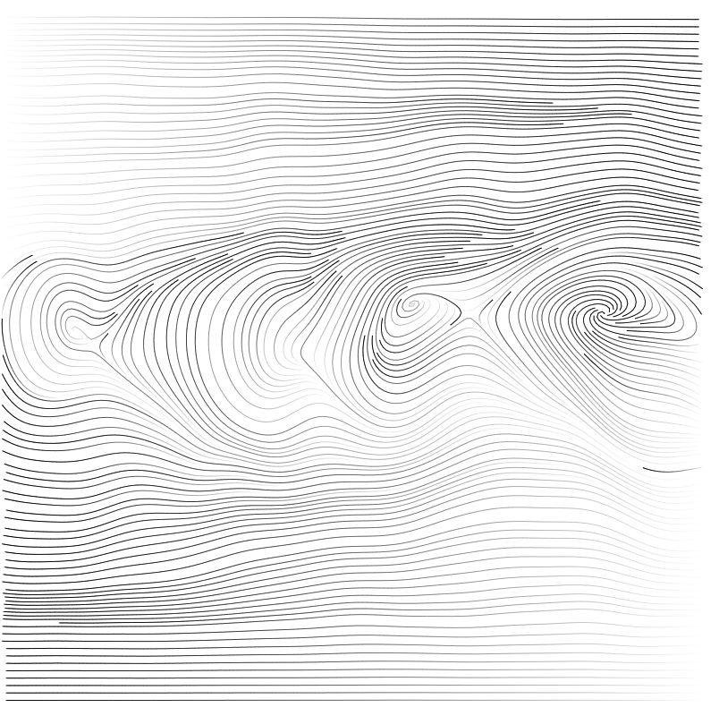
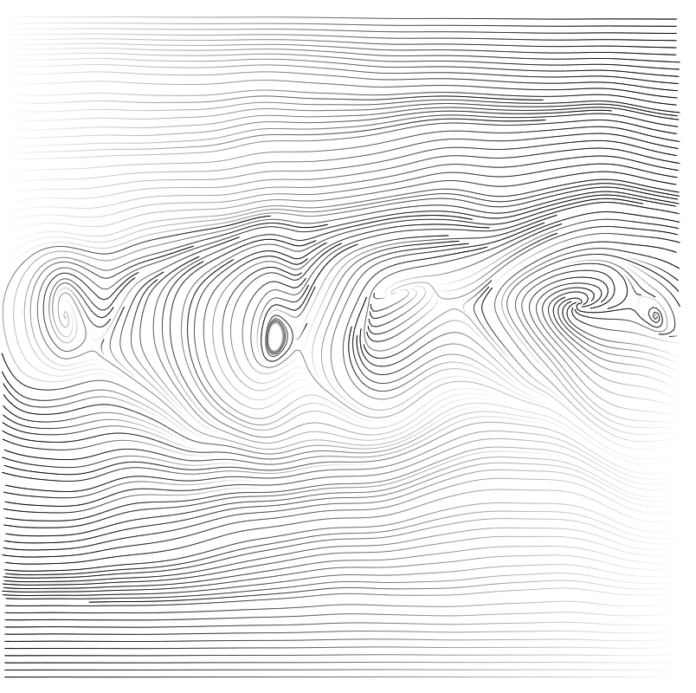
Granular Flow
Original
Gaussian Filter
Random Walk

Slide 29
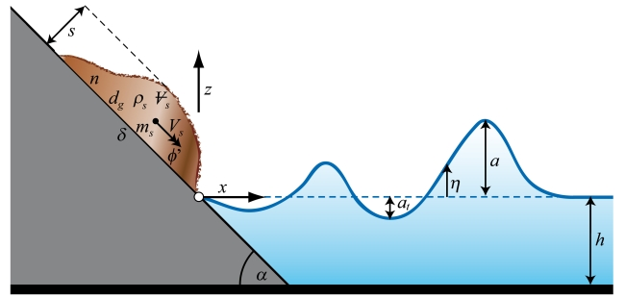
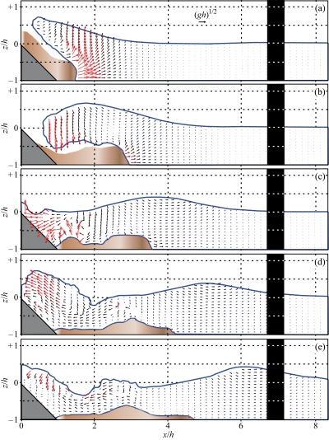
Landslide generated impulse waves
Heller, Landslide generated impulse waves (2007)
Notes:
Deslizamento de terra

Slide 30
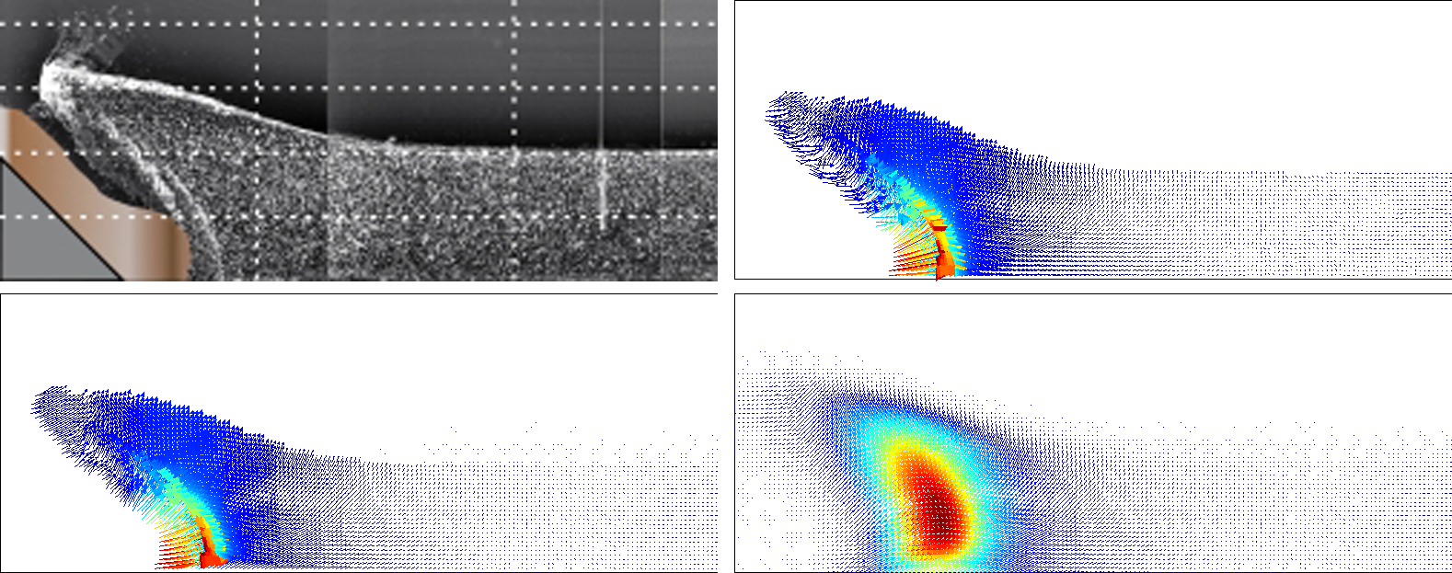
Landslide
Scheme
Original
Random Walk
Gaussian

Slide 31
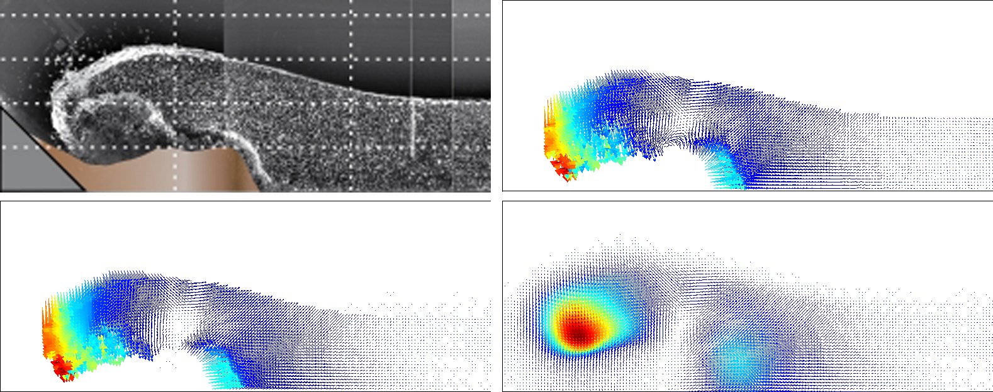
Landslide
Scheme
Original
Random Walk
Gaussian

Slide 32
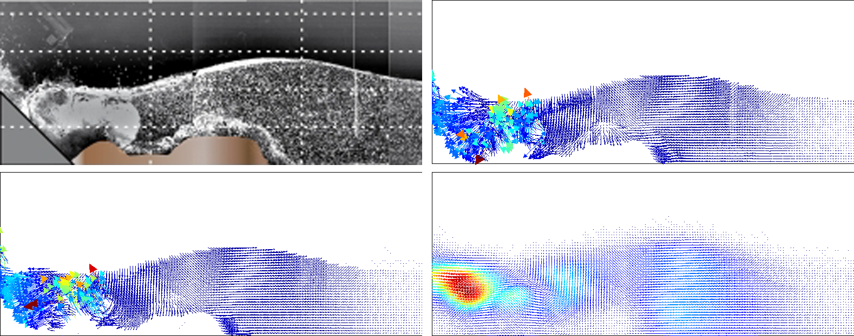
Landslide
Scheme
Original
Random Walk
Gaussian

Slide 33
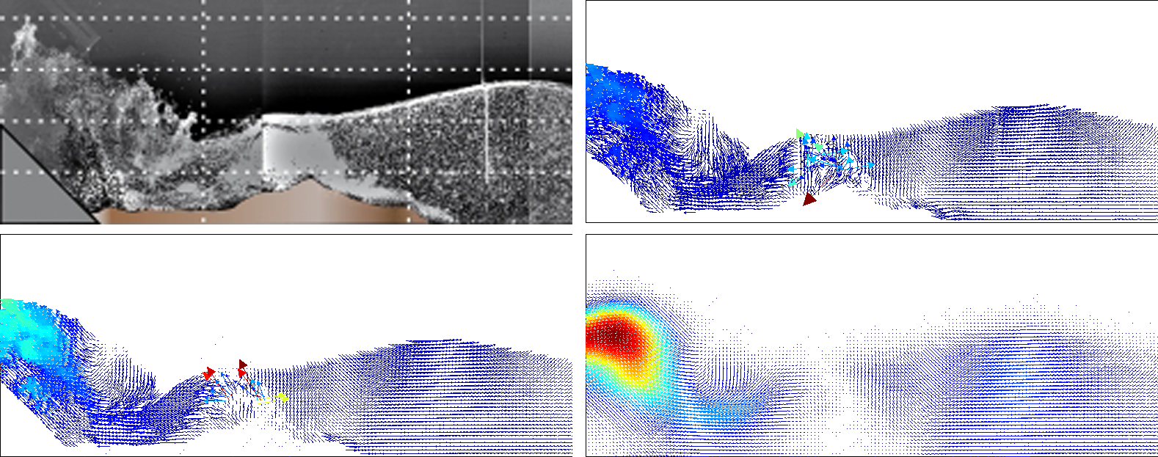
Landslide
Scheme
Original
Random Walk
Gaussian

Slide 34
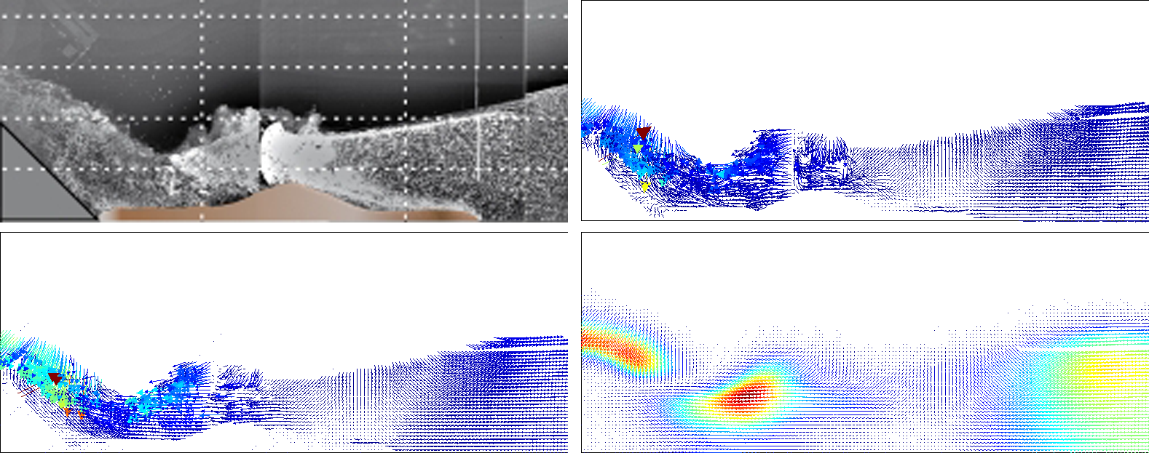
Landslide
Scheme
Original
Random Walk
Gaussian

Slide 35
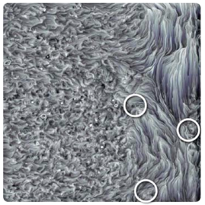
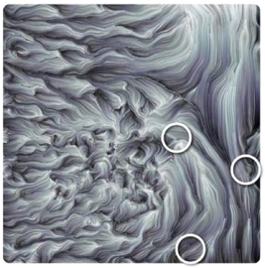
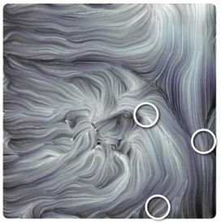
Wall Jet (PIV)
Delicate Tradeoff
Original
Scale n=30
Scale n=100

Slide 36
Topology-aware filtering
“Topology Aware Vector Field Denoising” SIBGRAPI(2010)

Slide 37
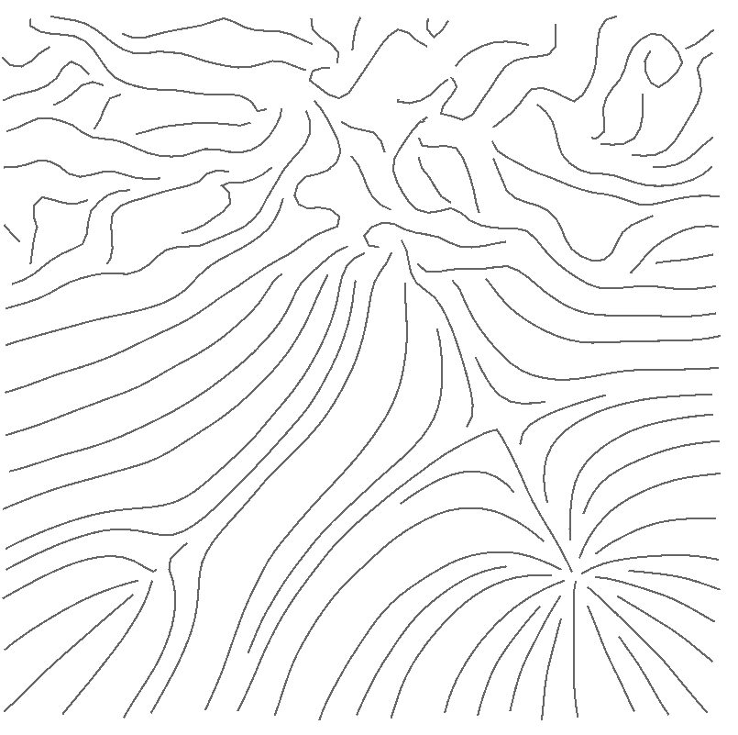
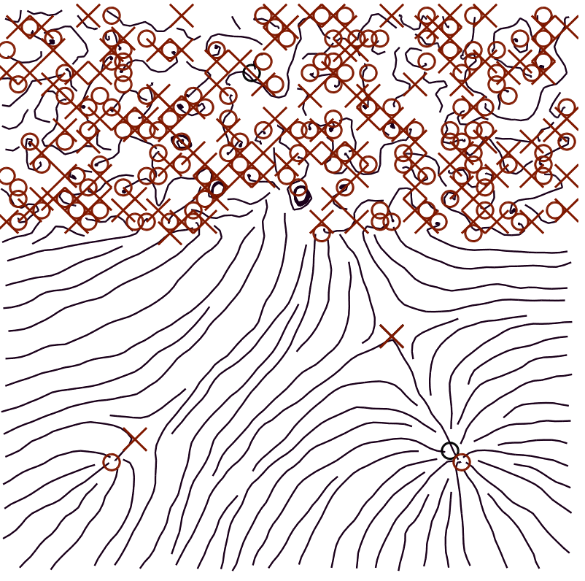
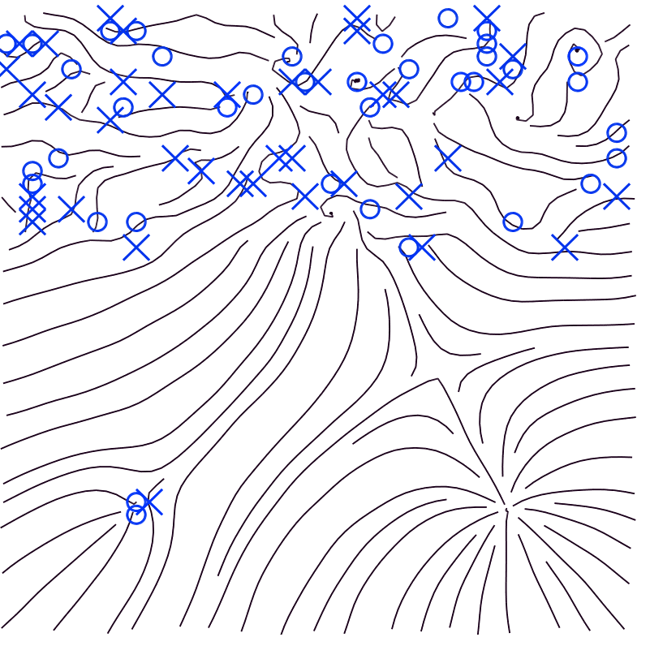
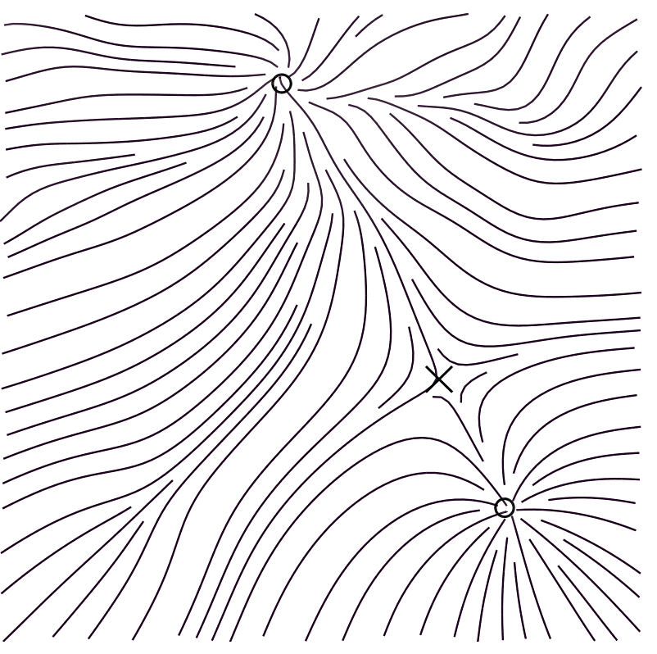
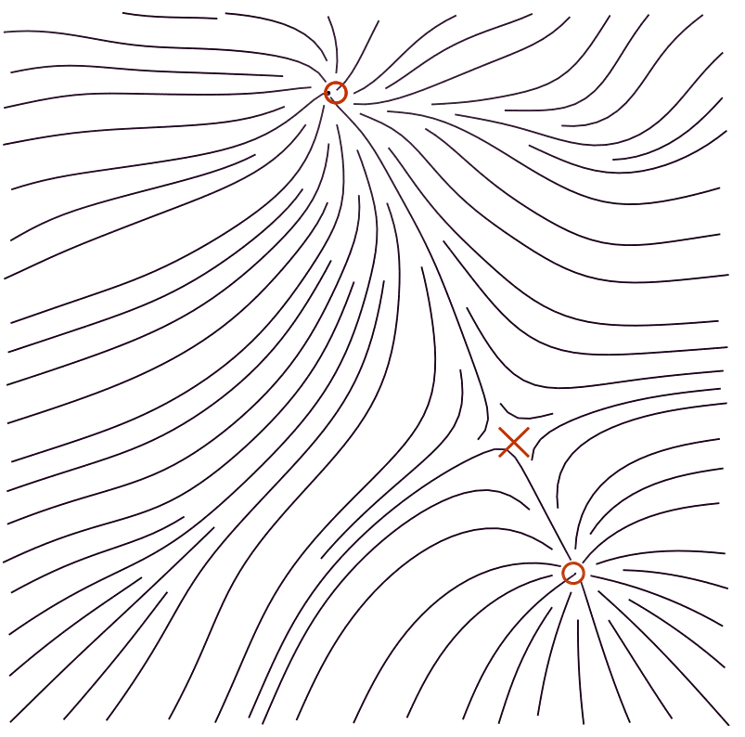
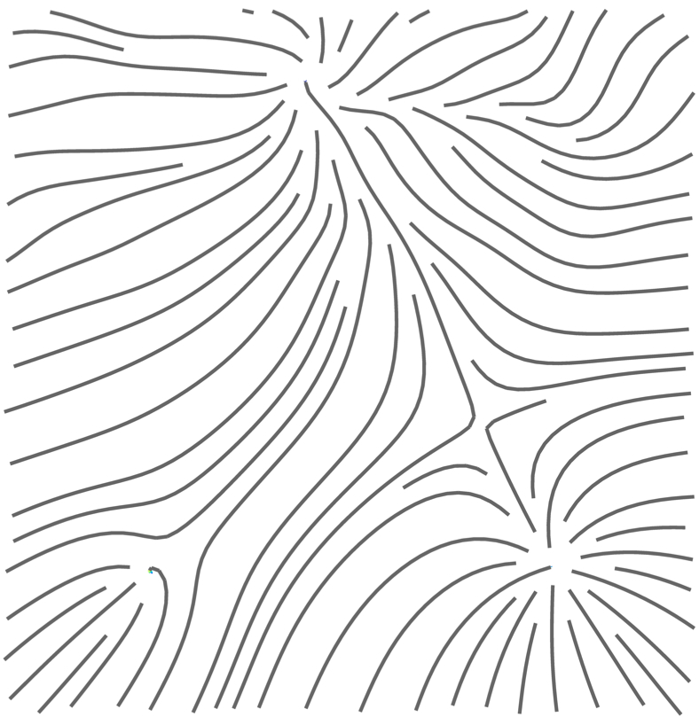
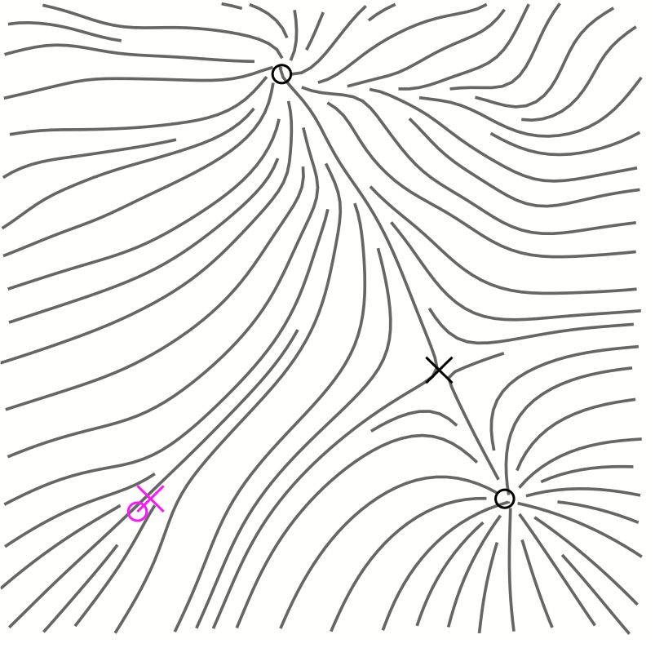
Topology Aware Filtering
Scale space
Original field
Global Information
Final field
Reconstruction
Adapt scale locally

Slide 38
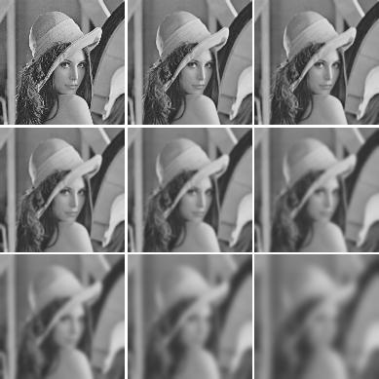
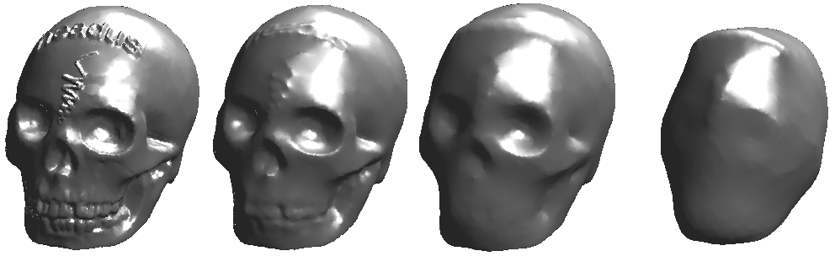
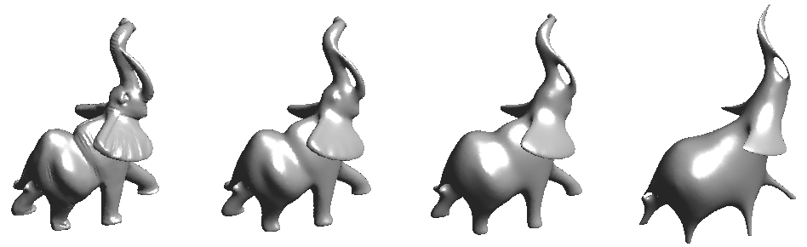
Scale Space
Hierarchical Representation

Slide 39
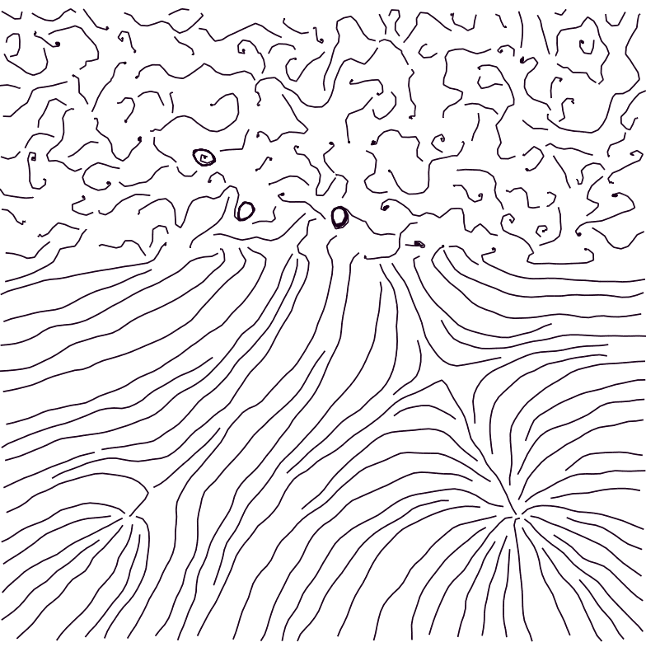
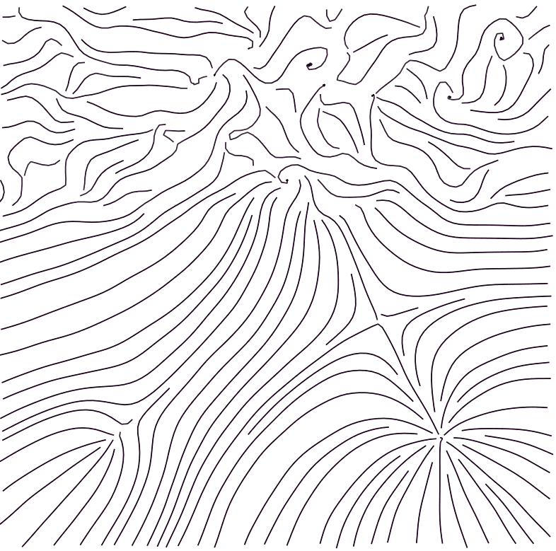


Vector Field Scale Space
Level of detail
Finer
Coarser
Scale
(i.e. parameters of Gaussian and Random Walk)

Slide 40

Topological change
Global information
Each change is associated with a local scale
Scale space

Slide 41

Control the scale with global information
Topological Information

Slide 42






Singularity Detection
Singular point
Bilinear Interpolation
Poincaré Index
Notes:
Contribuicao da dissertacao foi as formulas
Usamos os dois metodos mais a detecao foi a mesma

Slide 43
Topology Aware Filtering
Scale space
Original field
Global Information
Final field
Reconstruction
Adapt scale locally
Notes:
Idea geral

Slide 44

User interaction

Slide 45


Reconstruction
Interpolate the sampling provided by the user
Desired field
Notes:
INTERPOLA A ESCALA

Slide 46


Interpolation
Radial Basis Function interpolation
Shepard’s interpolation with kernels(Becker 2009)
Notes:
Raios diferentes

Slide 47
Results

Slide 48






Illustrative Example
Original
Noisy
User’s Choices
User Selection
Final Field
Final Field
(larger radius)

Slide 49
Granular Flow
Original
Gaussian
Topology-aware

Slide 50

Wall jet
Original
Scale n=30
Scale n=100
Topology-aware
Notes:
Outra parte do PIV

Slide 51


Wall jet
Original
Topology-aware
Gaussian

Slide 52

Timings

Slide 53


Limitations
Random walk filter
Number of parameters
Data dependency
Topology-aware filter
Local singularity detection
Singularity displacement
Notes:
Limitacao

Slide 54


Future Work
-3D vector field denoising
-Different similarity functions
-Tracking of singularities

Slide 55
Thank you for your attention
-Special thanks to Helio Lopes and Thomas Lewiner
-Thanks to my collaborators in this work Renata Nascimento, Marcos Lage, Fabiano Petronetto, Alex Bordignon, Sinésio Pesco, and Geovan Tavares
-Thanks to PUC-Rio, CNPq, FAPERJ for the financial support
-Thanks to Luis Fernando Alzuguir and Juliana Abrantes for the PIV data

